Slide 1

REVA HACK- 2021 Patron Augury
Team name: STARK
Team Leader: Sowmya Sree T
Team members: C Sri Sravya
Raksha R Y
Theme:
Customer churn prediction

Slide 2

Problem Statement
Companies are working hard to survive in today’s competitive market as a result, increasing the cost of customer acquisition
It is therefore essential for the service providers to prevent churn
Churners are persons who move to other bank for various reasons
The aim of Customer Churn Prediction Model is to detect customers with high tendency to leave a bank

Slide 3
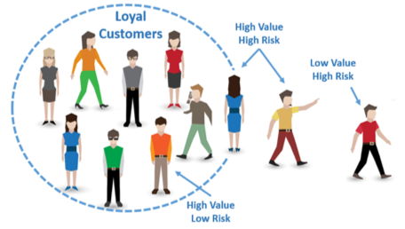
Necessity of the model
Provide exceptional Customer service
Helps manage the direct loss of revenue
Reduce the risk of business
Detailed and graphical form of information helps improvement of service

Slide 4
Sources used
Random Forest Algorithm through Machine Learning
Kaggle Data Set
Comprises 10000 customers
Spread over 10 attributes
Python Libraries
Numpy
Pandas
MatPlotLib
Seaborn

Slide 5
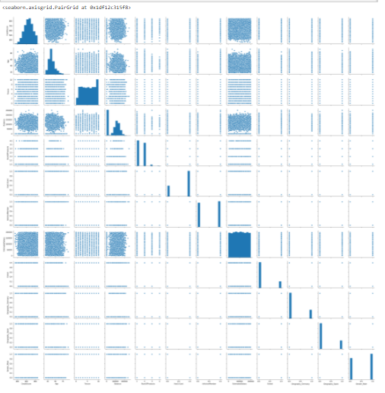
Proposed Solution
We try to build a model that uses Random Forest Classification to identify the churn customers
It also provides the factors behind the churning of customers in the banking sector

Slide 6
Attributes used for analysis
Credit score
Location of the Customer
Gender
Age
Tenure
Account Balance
Number of Bank Products Customer Uses
Has Credit Card
Is Active Member
Estimated Salary

Slide 7
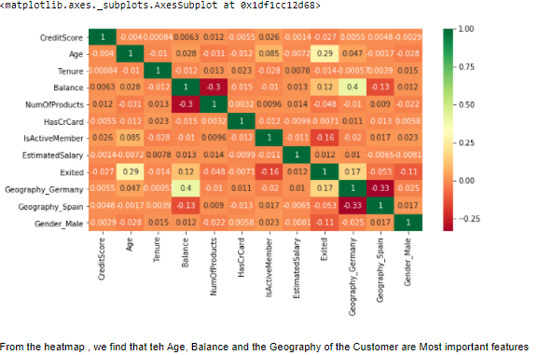

Slide 8
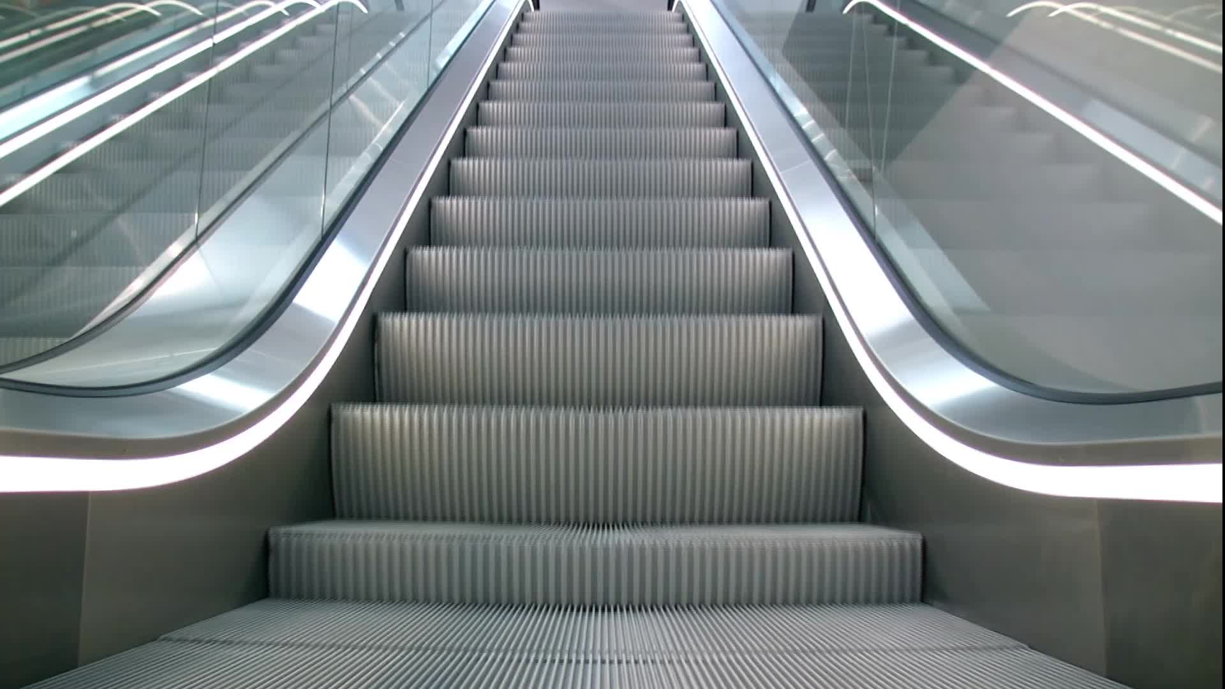
Conclusion
In future , the model can be further extended to explore the changing behavior patterns of churn customers by applying AI
We can also make an option for other banks to add data and various other attributes to this dataset for their churn analysis

Slide 9
THANK YOU

